Slide 1
Analysis of Algorithms
Time Complexity and
Asymptotic Analysis
Mushtari Sadia

Slide 2
Analysis of Algorithms
An algorithm is a finite set of precise instructions for performing a computation or for solving a problem.
What is the goal of analysis of algorithms?
To compare algorithms mainly in terms of running time but also in terms of other factors (e.g., memory requirements, programmer's effort etc.)
What do we mean by running time analysis?
Determine how running time increases as the input size of the problem increases.

Slide 3
Types of Analysis
Worst case
Provides an upper bound on running time
An absolute guarantee that the algorithm would not run longer, no matter what the inputs are
Best case
Provides a lower bound on running time
Input is the one for which the algorithm runs the fastest
Average case
Provides a prediction about the running time
Assumes that the input is random

Slide 4
How do we compare algorithms?
We need to define a number of objective measures.
(1) Compare execution times?
Not good: times are specific to a particular computer !!
(2) Count the number of statements executed?
Not good: number of statements vary with the programming language as well as the style of the individual programmer.

Slide 5
Ideal Solution
Express running time as a function of the input size n (i.e., f(n)).
Compare different functions corresponding to running times.
Such an analysis is independent of machine time, programming style, etc.

Slide 6
Example
Associate a "cost" with each statement.
Find the "total cost“ by finding the total number of times each statement is executed.
Algorithm 1 Algorithm 2
Cost Cost
arr[0] = 0; c₁ for(i=0; i<N; i++) c₂
arr[1] = 0; c₁ arr[i] = 0; c₁
arr[2] = 0; c₁
... ...
arr[N-1] = 0; c₁
----------- -------------
c₁+c₁+...+c₁ = c₁ x N (N+1) x c₂ + N x c₁ =
(c₂ + c₁) x N + c₂

Slide 7
Another Example
Algorithm 3 Cost
sum = 0; c₁
for(i=0; i<N; i++) c₂
for(j=0; j<N; j++) c₂
sum += arr[i][j]; c₃
------------
c₁ + c₂ x (N+1) + c₂ x N x (N+1) + c₃ x N²

Slide 8

If-then-else Statement
if(condition)
i = 0;
else
for ( j = 0; j < n; j++)
a[j] = j;

Slide 9
Consecutive Statements
for (j = 0; j < n; ++j) {
// 3 atomics
}
for (j = 0; j < n; ++j) {
// 5 atomics
}

Slide 10
Nested Loop Statements
Analyze such statements inside out
for (j = 0; j < n; ++j) {
// 2 atomics
for (k = 0; k < n; ++k) {
// 3 atomics
}
}
Complexity = (2 + 3n)n

Slide 11
Example
Code:
a = b;
Complexity:
Notes:
constant

Slide 12
Example
Code:
sum = 0;
for (i=1; i <=n; i++)
sum += n;
Complexity:
Notes:
linear

Slide 13
Example
Code:
sum1 = 0;
for (i=1; i<=n; i++)
for (j=1; j<=n; j++)
sum1++;
Complexity:
Notes:
Obviousy n squared

Slide 14
Example
Code:
sum2 = 0;
for (i=1; i<=n; i++)
for (j=1; j<=i; j++)
sum2++;
Complexity:

Slide 15
Example
Code:
sum = 0;
for (j=1; j<=n; j++)
for (i=1; i<=j; i++)
sum++;
for (k=0; k<n; k++)
A[k] = k;
Complexity:
Notes:
N squared == 1 + 2 + … + N

Slide 16
Example
Code:
sum1 = 0;
for (k=1; k<=n; k*=2)
for (j=1; j<=n; j++)
sum1++;
Complexity:
Notes:
outer loop O(lg N), inner loop (N) == O (N lg N) by product rule

Slide 17
Example
Code:
sum2 = 0;
for (k=1; k<=n; k*=2)
for (j=1; j<=k; j++)
sum2++;
Complexity:
Notes:
outer O (lg N) inner = sum of powers of 2 which is linear since
The sum of powers of 2 dividing into N is 2N so its O (N lg N) by product rule

Slide 18
Asymptotic Analysis
To compare two algorithms with running times f(n) and g(n), we need a rough measure that characterizes how fast each function grows.
Hint: use rate of growth
Compare functions in the limit, that is, asymptotically!
(i.e., for large values of n)

Slide 19
Rate of Growth
Consider the example of buying a car and a packet of biscuits:
Cost: cost_of_car + cost_of_biscuit
Cost ~ cost_of_car (approximation)
The low order terms in a function are relatively insignificant for large n
n⁴ + 100n² + 10n + 50 ~ n⁴
i.e., we say that n⁴ + 100n² + 10n + 50 and n⁴ have the same rate of growth

Slide 20
Asymptotic Notation
O notation: asymptotic “less than”:
f(n)=O(g(n)) implies: f(n) “≤” g(n)
Ω notation: asymptotic “greater than”:
f(n)= Ω (g(n)) implies: f(n) “≥” g(n)
Θ notation: asymptotic “equality”:
f(n)= Θ (g(n)) implies: f(n) “=” g(n)

Slide 21
Big-O Notation
We say f_{A}(n)=30n+8 is order n, or O (n) It is, at most, roughly proportional to n.
f_{B}(n)=n²+1 is order n², or O(n²). It is, at most, roughly proportional to n².
In general, any O(n²) function is faster- growing than any O(n) function.

Slide 22
Visualizing Orders of Growth
On a graph, as you go to the right, a faster growing function eventually becomes larger...
f_{A}(n)=30n+8
Value of function →
f_{B}(n)=n²+1
Increasing n →

Slide 23
More Examples …
n⁴ + 100n² + 10n + 50 is O(n⁴)
10n³ + 2n² is O(n³)
n³ - n² is O(n³)
constants
10 is O(1)
1273 is O(1)

Slide 24
Back to Our Example
Algorithm 1 Algorithm 2
Cost Cost
arr[0] = 0; c₁ for(i=0; i<N; i++) c₂
arr[1] = 0; c₁ arr[i] = 0; c₁
arr[2] = 0; c₁
...
arr[N-1] = 0; c₁
----------- -------------
c₁+c₁+...+c₁ = c₁ x N (N+1) x c₂ + N x c₁ =
(c₂ + c₁) x N + c₂
Both algorithms are of the same order: O(N)

Slide 25
Example (cont’d)
Algorithm 3 Cost
sum = 0; c₁
for(i=0; i<N; i++) c₂
for(j=0; j<N; j++) c₂
sum += arr[i][j]; c₃
------------
c₁ + c₂ x (N+1) + c₂ x N x (N+1) + c₃ x N² = O(N²)

Slide 26
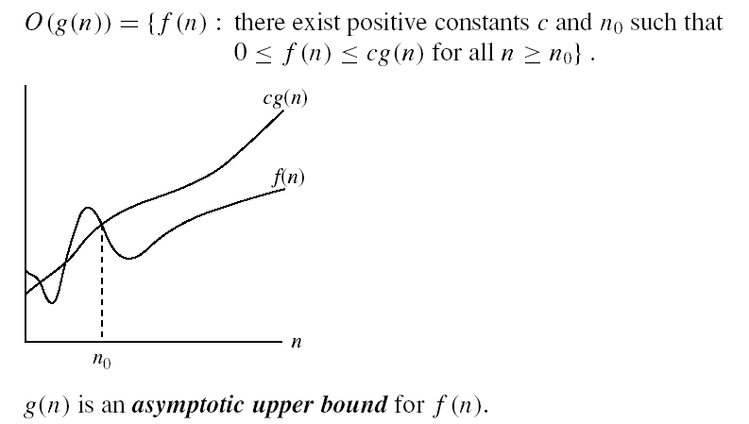
Asymptotic notations
O-notation

Slide 27
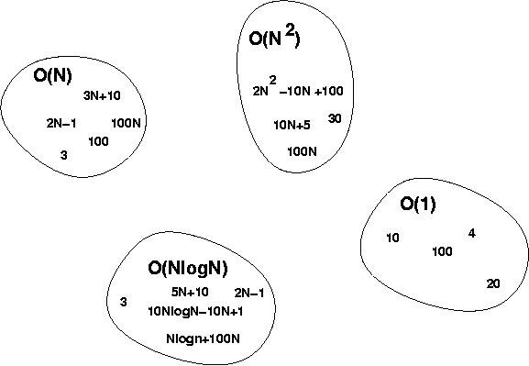
Big-O Visualization
O(g(n)) is the set of functions with smaller or same order of growth as g(n)

Slide 28
Examples
2n² = O(n³):
n² = O(n²):
1000n²+1000n = O(n²):
n = O(n²):
2n² ≤ cn³ ⇒ 2 ≤ cn ⇒ c = 1 and n₀= 2
n² ≤ cn² ⇒ c ≥ 1 ⇒ c = 1 and n₀= 1
1000n²+1000n ≤ 1000n²+ n² =1001n²⇒ c=1001 and n₀ = 1000
n ≤ cn² ⇒ cn ≥ 1 ⇒ c = 1 and n₀= 1

Slide 29
More Examples
Show that 30n+8 is O(n).
Show ∃c,n₀: 30n+8 ≤ cn, ∀n>n₀ .
Let c=31, n₀=8. Assume n>n₀=8. Then cn = 31n = 30n + n > 30n+8, so 30n+8 < cn.

Slide 30
Big-O example, graphically
Note 30n+8 isn’t less than n anywhere (n>0).
It isn’t even less than 31n everywhere.
But it is less than 31n everywhere to the right of n=8.
cn = 31n
30n+8
30n+8 ∈O(n)
Value of function →
n
n>n₀=8 →
Increasing n →

Slide 31
No Uniqueness
There is no unique set of values for n₀ and c in proving the asymptotic bounds
Prove that 100n + 5 = O(n²)
100n + 5 ≤ 100n + n = 101n ≤ 101n²
for all n ≥ 5
n₀ = 5 and c = 101 is a solution
100n + 5 ≤ 100n + 5n = 105n ≤ 105n² for all n ≥ 1
n₀ = 1 and c = 105 is also a solution
Must find SOME constants c and n₀ that satisfy the asymptotic notation relation

Slide 32
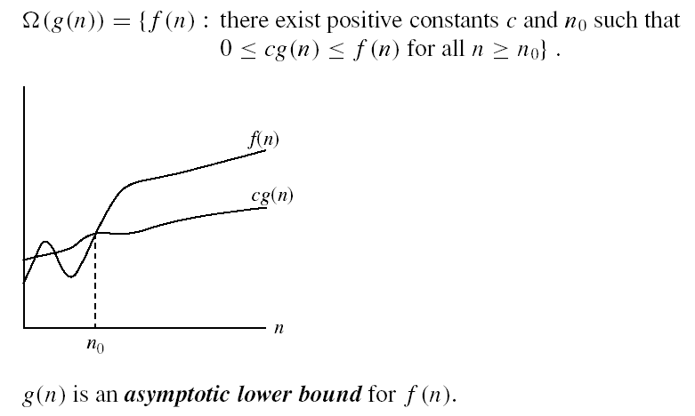
Asymptotic notations (cont.)
Ω - notation
Ω(g(n)) is the set of functions with larger or same order of growth as g(n)

Slide 33
Examples
5n² = Ω(n)
100n + 5 ≠ Ω(n²)
n = Ω(2n), n³ = Ω(n²), n = Ω(logn)
∃ c, n₀ such that: 0 ≤ cn ≤ 5n²
⇒ cn ≤ 5n²
⇒ c = 5 and n₀ = 1
∃ c, n₀ such that: 0 ≤ cn² ≤ 100n + 5
100n + 5 ≤ 100n + 5n (∀ n ≥ 1) = 105n
cn² ≤ 105n
⇒ n(cn – 105) ≤ 0
Since n is positive ⇒ cn – 105 ≤ 0
⇒ n ≤ 105/c
⇒ contradiction: n cannot be smaller than a constant

Slide 34

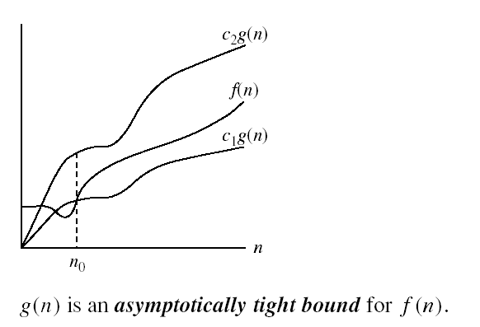
Asymptotic notations (cont.)
Θ-notation
Θ(g(n)) is the set of functions with the same order of growth as g(n)

Slide 35
Examples
n²/2 –n/2 = Θ(n²)
½ n² - ½ n ≤ ½ n² ∀n ≥ 0 ⇒ c₂= ½
½ n² - ½ n ≥ ½ n² - ½ n * ½ n ( ∀n ≥ 2 ) = ¼ n² ⇒ c₁= ¼
n ≠ Θ(n²): c₁ n² ≤ n ≤ c₂ n²
⇒ only holds for: n ≤ 1/c₁

Slide 36
Relations Between Different Sets
Subset relations between order-of-growth sets.
R→R
O( f )
Ω( f )
• f
Θ( f )

Slide 37
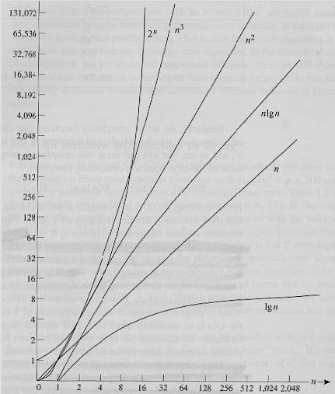
Common orders of magnitude

Slide 38
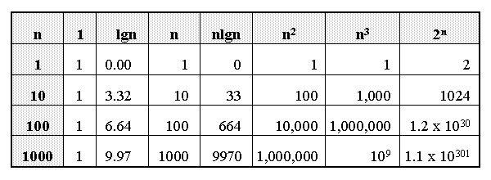
Growth of Functions

Slide 39
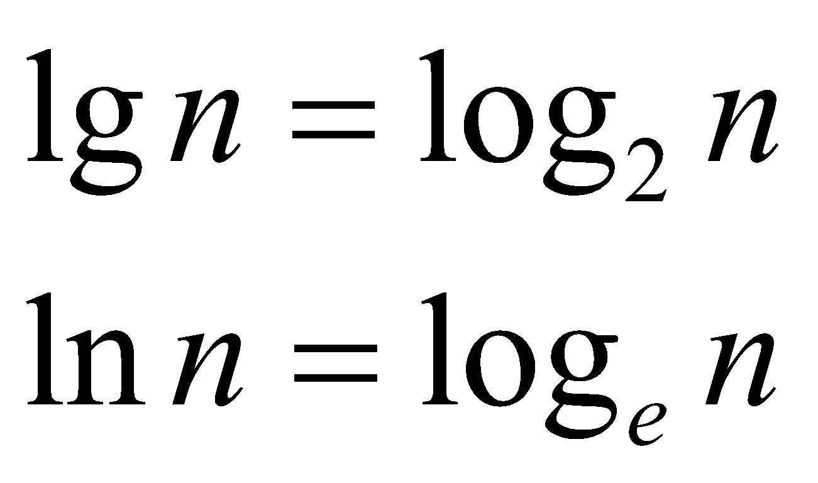
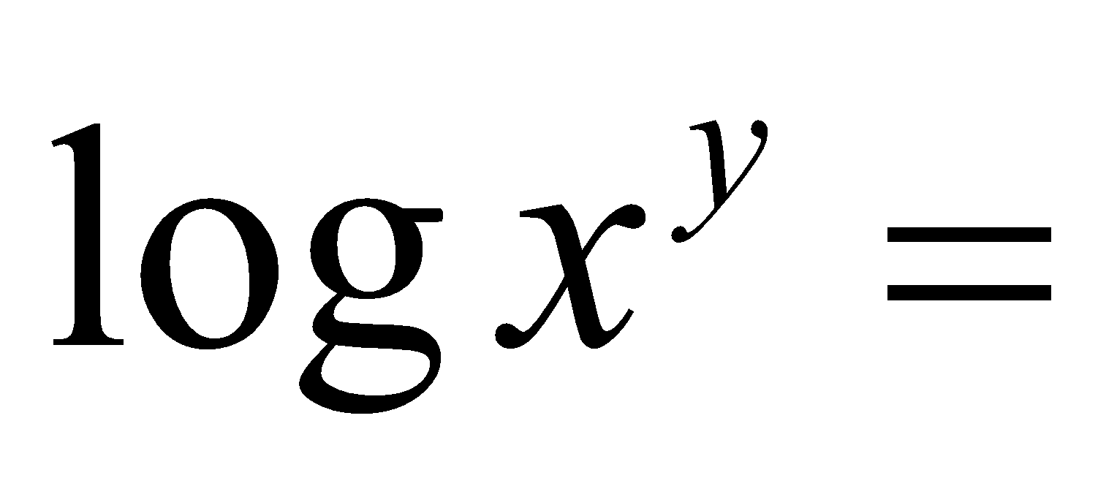
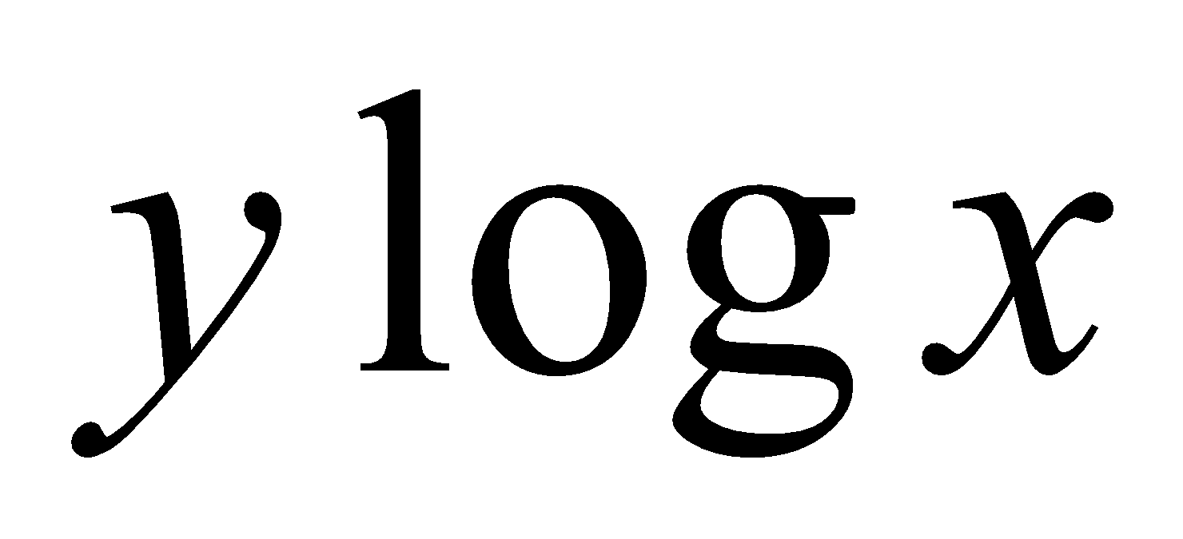
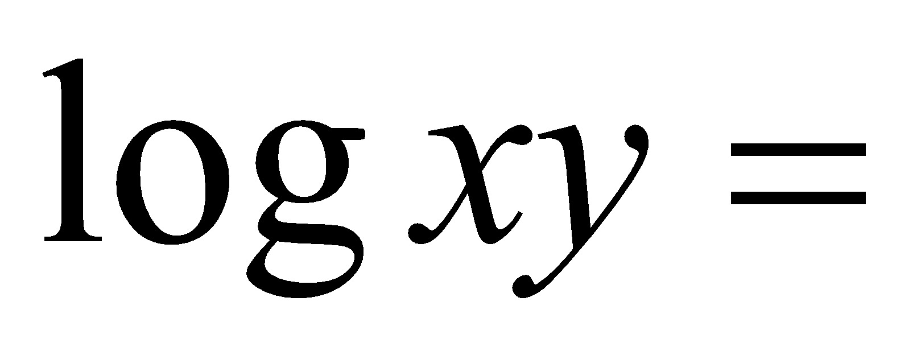
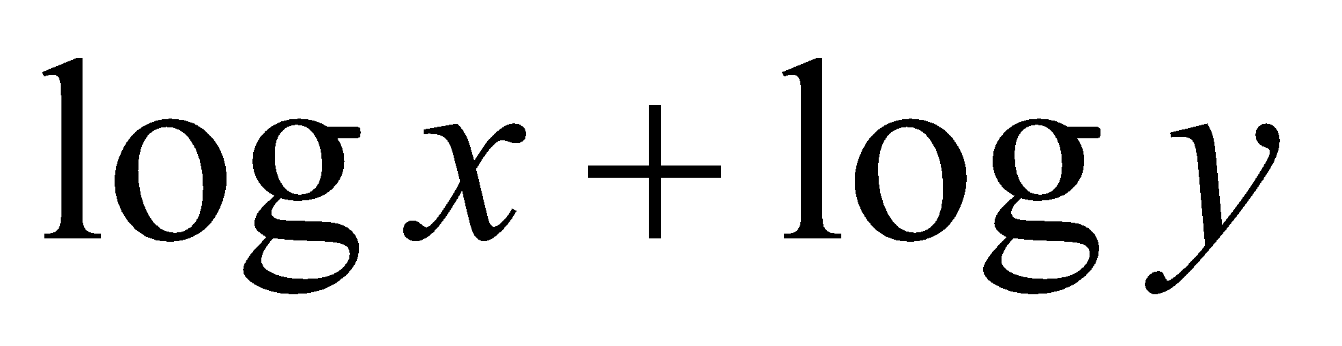
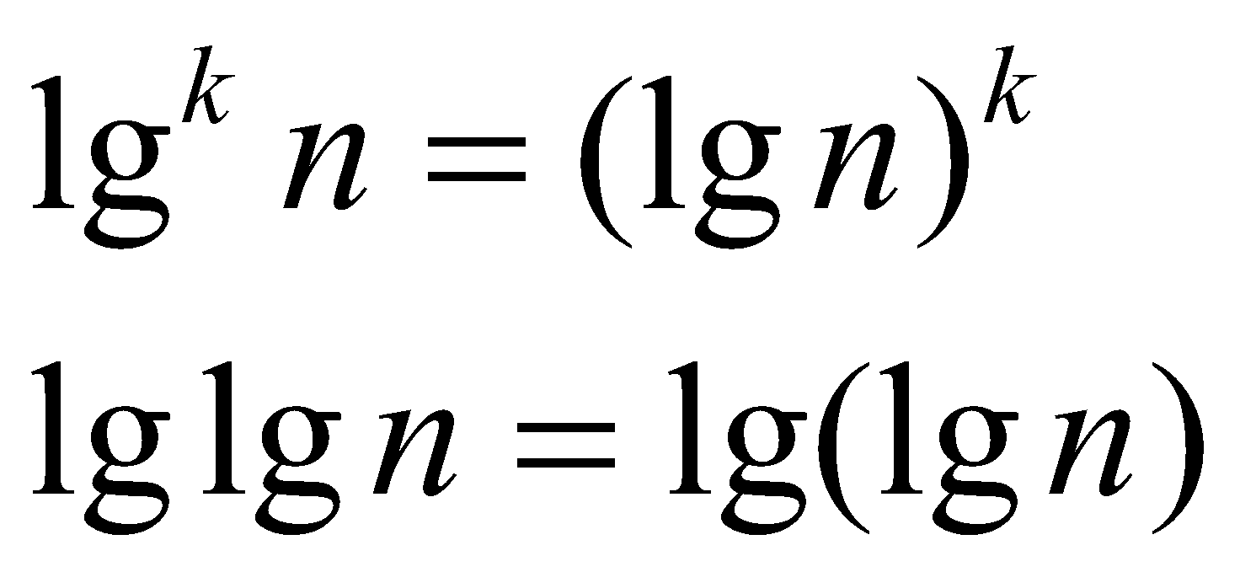
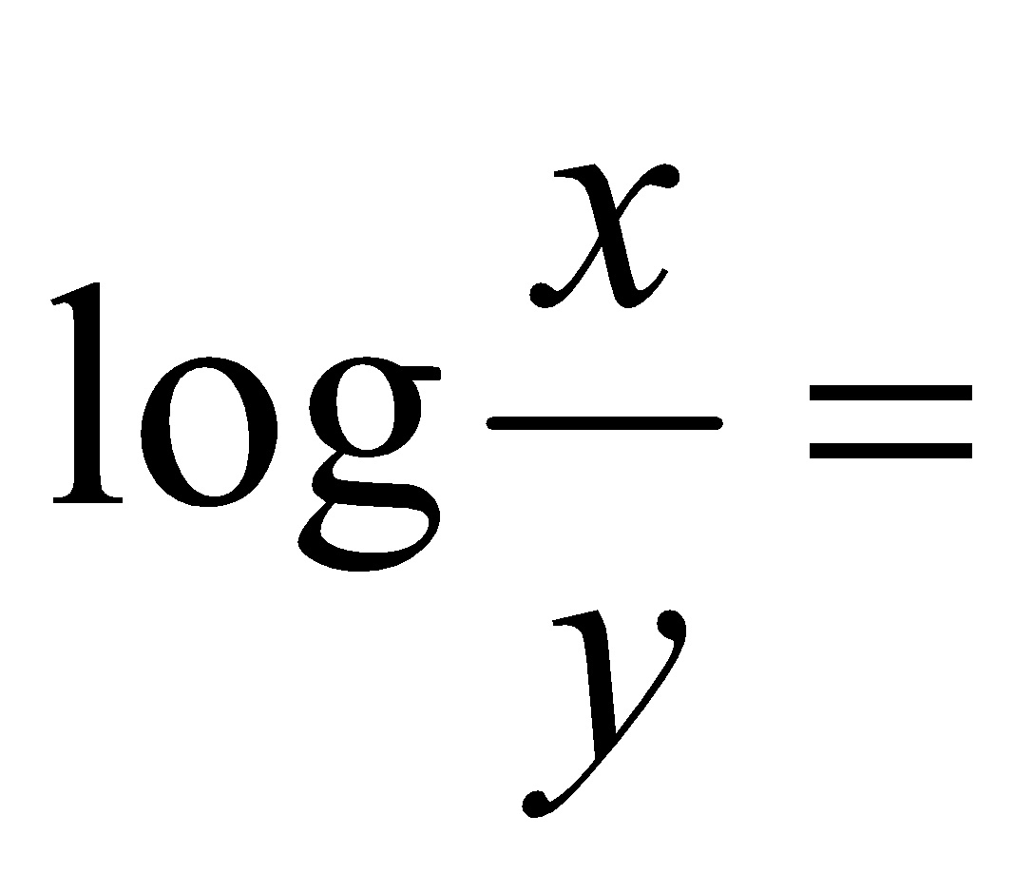
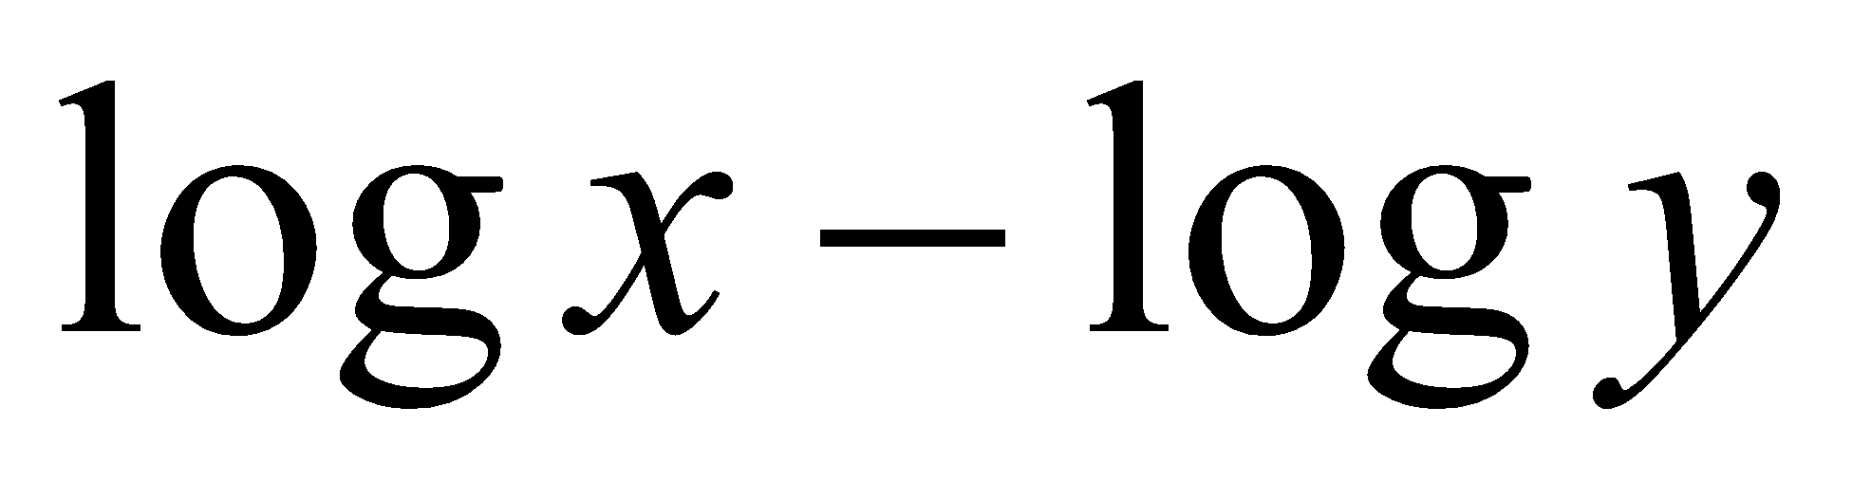
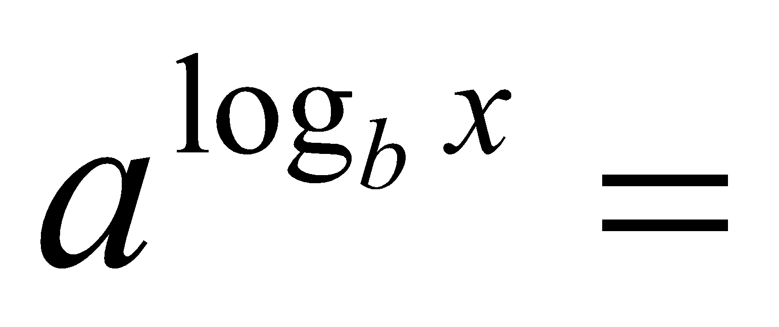
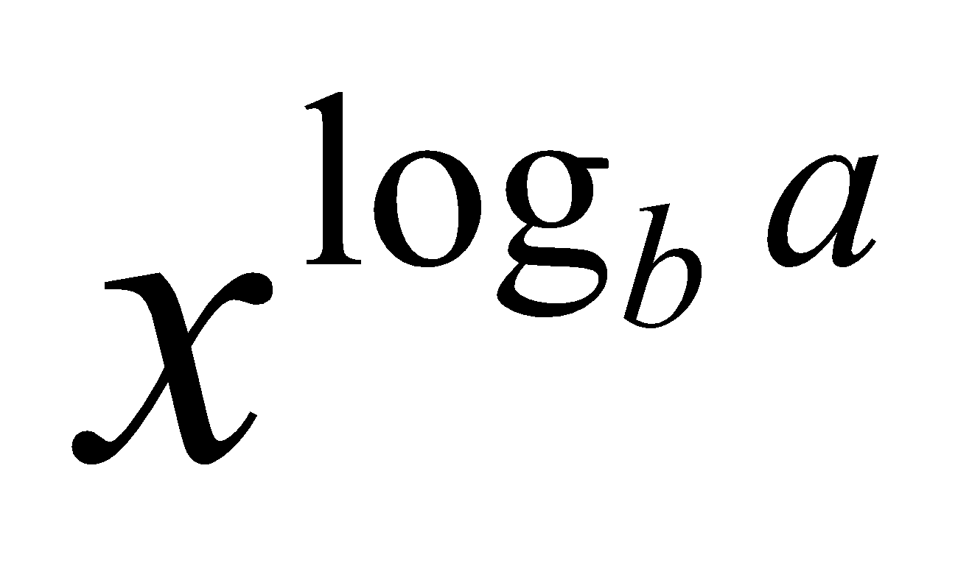
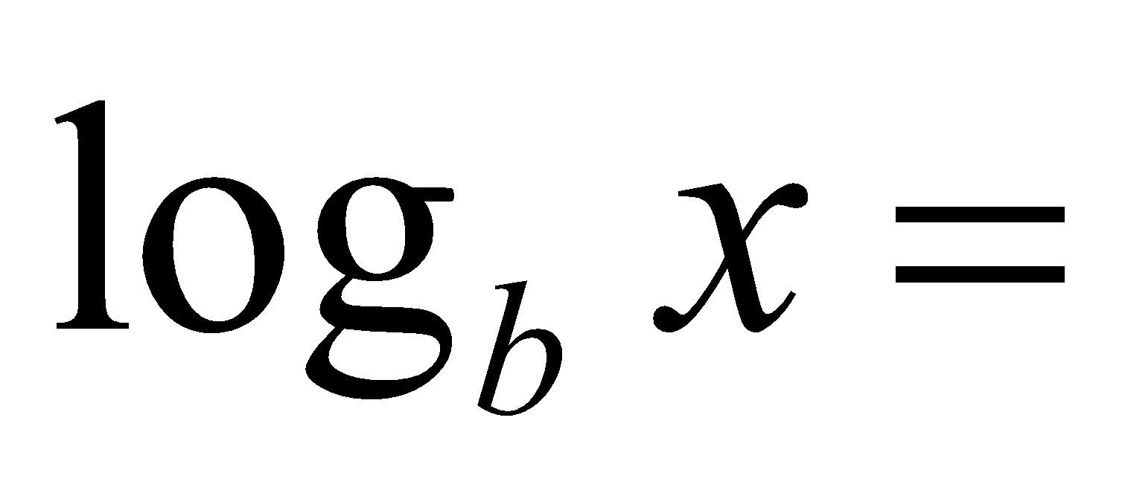
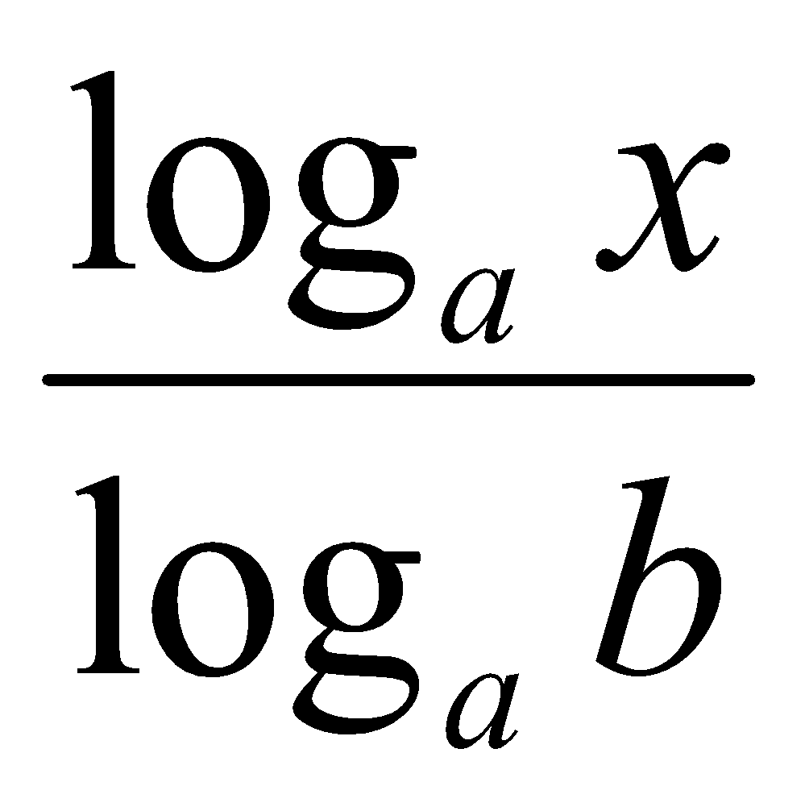
Logarithms and properties
In algorithm analysis we often use the notation “log n” without specifying the base
Binary logarithm
Natural logarithm

Slide 40
More Examples
For each of the following pairs of functions, either f(n) is O(g(n)), f(n) is Ω(g(n)), or f(n) = Θ(g(n)). Determine which relationship is correct.
f(n) = log n²; g(n) = log n + 5
f(n) = n; g(n) = log n²
f(n) = log log n; g(n) = log n
f(n) = n; g(n) = log² n
f(n) = n log n + n; g(n) = log n
f(n) = 10; g(n) = log 10
f(n) = 2^{n}; g(n) = 10n²
f(n) = 2^{n}; g(n) = 3^{n}
f(n) = Θ (g(n))
f(n) = Ω(g(n))
f(n) = O(g(n))
f(n) = Ω(g(n))
f(n) = Ω(g(n))
f(n) = Θ(g(n))
f(n) = Ω(g(n))
f(n) = O(g(n))

Slide 41
Asymptotic Notations - Examples
Θ notation
n²/2 – n/2
(6n³ + 1)lgn/(n + 1)
n vs. n²
Ω notation
n³ vs. n²
n vs. logn
n vs. n²
= Θ(n²)
= Θ(n²lgn)
n ≠ Θ(n²)
O notation
2n² vs. n³
n² vs. n²
n³ vs. nlogn
2n² = O(n³)
n² = O(n²)
n³ = Ω(n²)
n³ ≠ O(nlgn)
n = Ω(logn)
n ≠ Ω(n²)

Slide 42
Simplifying Assumptions
1. If f(n) = O(g(n)) and g(n) = O(h(n)), then f(n) = O(h(n))
2. If f(n) = O(kg(n)) for any k > 0, then f(n) = O(g(n))
3. If f₁(n) = O(g₁(n)) and f₂(n) = O(g₂(n)),
then f₁(n) + f₂(n) = O(max (g₁(n), g₂(n)))
4. If f₁(n) = O(g₁(n)) and f₂(n) = O(g₂(n)),
then f₁(n) * f₂(n) = O(g₁(n) * g₂(n))

Slide 43
Some Simplified Rules
O(1) = c , where c is a constant
O(n) = c*n = cn , where c is constant and n is variable
c₁*O(1) = c₁*c = c₂ = O(1) , where c,c₁,c₂ are constants
O(1) + O(1) + O(1) = 3*O(1) = O(1)
5*O(1) = O(1)
n*O(1) = n*c = cn = O(n) , where c is constant and n is variable
O(m) + O(n) ≠ O(m+n)
O(m) * O(n) = c₁m * c₂n = (c₁*c₂)(mn) = (c₂)(mn) = O(mn)
O(m)*O(n)*O(p)*O(q) = O(m(n(p(q)))) = O(mnpq)
Example nested for loops
O(an² + bn + c) = O(n²) where a, b , c are constants

Slide 44
Example #1: carry n books from one bookshelf to another one
How many operations?
n pick-ups, n forward moves, n drops and n reverse moves 🡪 4 n operations
4n operations = c. n = O(c. n) = O(n)
Similarly, any program that reads n inputs from the user will have minimum time complexity O(n).

Slide 45
Example #2: Locating Roll-Number record in Attendance Sheet
What is the time complexity of search?
Binary Search algorithm at work
O(log n)
Sequential search?
O(n)

Slide 46
Example #3: Teacher of CSE 221 gives gifts to first 10 students
There are n students in the queue.
Teacher brings one gift at a time.
Time complexity = O(c. 10) = O(1)
Teacher will take exactly same time irrespective of the line length.

Slide 47
Loops with Break
for (j = 0; j < n; ++j) {
// 3 atomics
if (condition) break;
}
Upper bound = O(4n) = O(n)
Lower bound = Ω(4) = Ω(1)
Complexity = O(n)

Slide 48
Sequential Search
Given an unsorted vector/list a[ ], find the location of element X.
for (i = 0; i < n; i++) {
if (a[i] == X) return true;
}
return false;
Input size: n = array size()
Complexity = O(n)

Slide 49
If-then-else Statement
if(condition)
i = 0;
else
for ( j = 0; j < n; j++)
a[j] = j;
Complexity = ??
= O(1) + max ( O(1), O(N))
= O(1) + O(N)
= O(N)

Slide 50
Consecutive Statements
for (j = 0; j < n; ++j) {
// 3 atomics
}
for (j = 0; j < n; ++j) {
// 5 atomics
}
Add the complexity of consecutive statements
Complexity = O(3n + 5n) = O(n)

Slide 51
Nested Loop Statements
Analyze such statements inside out
for (j = 0; j < n; ++j) {
// 2 atomics
for (k = 0; k < n; ++k) {
// 3 atomics
}
}
Complexity = (2 + 3n)n = O(n^2)

Slide 52
Example
Code:
a = b;
Complexity:
O(1)
Notes:
constant

Slide 53
Example
Code:
sum = 0;
for (i=1; i <=n; i++)
sum += n;
Complexity:
O(n)
Notes:
linear

Slide 54
Example
Code:
sum1 = 0;
for (i=1; i<=n; i++)
for (j=1; j<=n; j++)
sum1++;
Complexity:
O(n^2)
Notes:
Obviousy n squared

Slide 55
Example
Code:
sum2 = 0;
for (i=1; i<=n; i++)
for (j=1; j<=i; j++)
sum2++;
Complexity:
O(n^2)

Slide 56
Example
Code:
sum = 0;
for (j=1; j<=n; j++)
for (i=1; i<=j; i++)
sum++;
for (k=0; k<n; k++)
A[k] = k;
Complexity:
O(n^2)
Notes:
N squared == 1 + 2 + … + N

Slide 57
Example
Code:
sum1 = 0;
for (k=1; k<=n; k*=2)
for (j=1; j<=n; j++)
sum1++;
Complexity:
O(nlogn)
Notes:
outer loop O(lg N), inner loop (N) == O (N lg N) by product rule

Slide 58
Example
Code:
sum2 = 0;
for (k=1; k<=n; k*=2)
for (j=1; j<=k; j++)
sum2++;
Complexity:
O(n)
Notes:
outer O (lg N) inner = sum of powers of 2 which is linear since
The sum of powers of 2 dividing into N is 2N so its O (N lg N) by product rule

